Slide 1

Kammavari Sangham (R) 1952, K.S.Group of Institutions
K. S SCHOOL OF ENGINEERING AND MANAGEMENT, BENGALURU-560109
(Affiliated to VTU, Belagavi & Approved by AICTE, New Delhi, Accredited by NAAC)
DEPARTMENT OF COMPUTER SCIENCE AND ENGINEERING Project Work Phase-2 (18CSP85) : Final Review
“ Language Pronunciation Translator For Better Understanding“
Batch No: 2021-22_CSE_19
Group No: 04
Name | USN
Hamsaveena S | 1KG18CS040
Karthik Gowda D | 1KG18CS045
Rama Reddy B T | 1KG18CS089
Shankar K S | 1KG18CS099
Under the Guidance of
Mrs . Jayashubha J
Assistant Professor
Department of Computer Science and Engineering

Slide 2
Introduction
Literature survey
Problem Statement
Objectives
Methodology / Design
Modules
Technology & Tools Used
Implementation / Snapshots
References
AGENDA

Slide 3
INTRODUCTION
Machine replication of human functions like reading is an ancient dream. However, over the last five decades, machine reading has grown from a dream to reality.
Visually impaired people report numerous difficulties with accessing printed text using existing technology, including problems with alignment, focus, accuracy, mobility and efficiency.
We present a smart device that assists the visually impaired and travelers which effectively and efficiently reads paper-printed text.
The proposed project uses the methodology of a camera based assistive device that can be used by people to read Text document.

Slide 4
The framework is on implementing image capturing technique in an embedded system based on Raspberry Pi board.
In this project we have proposed a text read out system for the traveler's and visually challenged.
The proposed fully integrated system has a camera as an input device to feed the printed text document for digitization. Speech is probably the most efficient medium for communication between humans.

Slide 5
LITERATURE SURVEY
Image to Speech Conversion for Visually Impaired
Asha G. Hagargundet et al carried out a work and they concluded that the basic framework is an embedded system that captures an image, extracts only the region of interest (i.e. region of the image that contains text) and converts that text to speech.
It is implemented using a Raspberry Pi and a Raspberry Pi camera. The captured image undergoes a series of image pre-processing steps to locate only that part of the image that contains the text and removes the background.
Two tools are used convert the new image (which contains only the text) to speech. They are OCR (Optical Character Recognition) software and TTS (Text-to-Speech) engines.
The audio output is heard through the raspberry pi’s audio jack using speakers or earphones.

Slide 6
PROBLEM STATEMENT
“To design and develop a system that supports multiple language recognition and translation by making use of advanced Speech Recognition System”
OBJECTIVES
Objective 1:The assistant asks the user for input and keeps listening for commands.
Objective 2:User interface is created to represent the image to text converter for computer based system.
Objective 3:This assistant can be customized to have either male or female voice according to user’s requirement.
Objective 4:The current version of the assistant supports features like Text translation, text synthesis and text extraction.

Slide 7
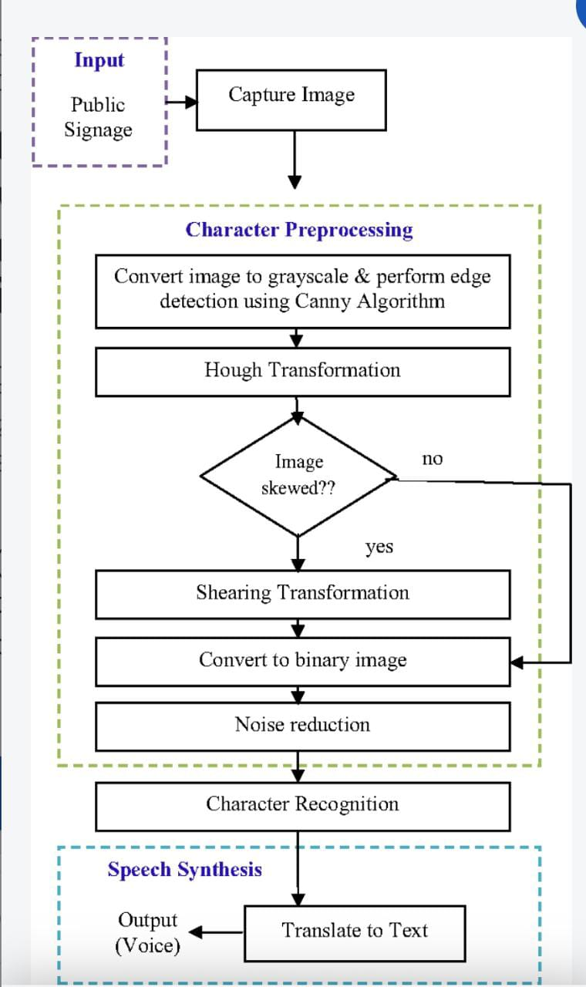
METHODOLOGY
Figure: flow chart to convert image to text

Slide 8

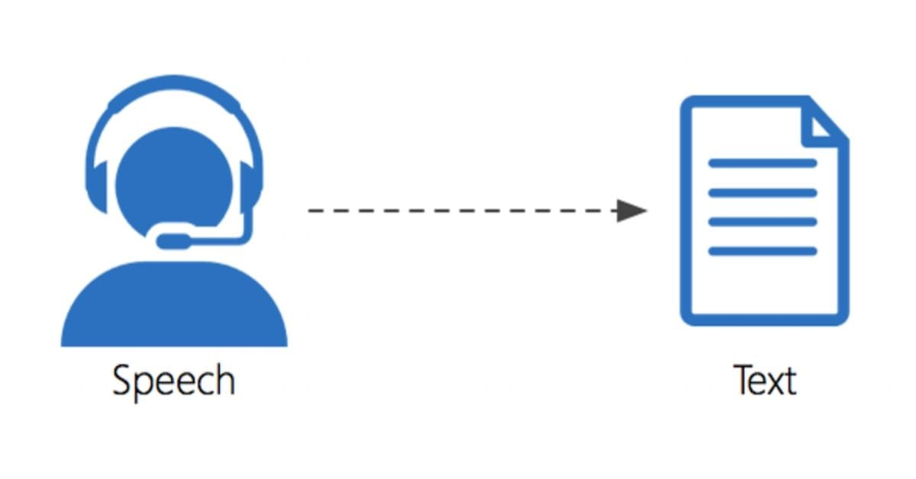
MODULES
Image to Text :
Insert an image in Jpeg format.
Extract the text in the image and give an output in text format.
Speech to Text:
System listens to the users speech or audio(mp3) and converts it into text format.

Slide 9
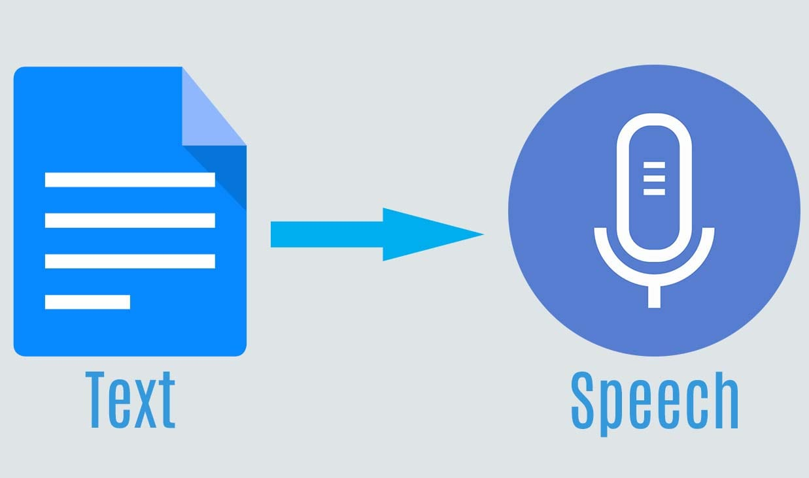
Text to Speech:
It convert the text format into the speech format .

Slide 10
TECHNOLOGY AND TOOLS USED
Software Requirements
Python 3.8
HTML
Windows / MAC OS / Ubuntu OS
Libraries Used:
Urllib3
Tk
Playsound
gTTs

Slide 11
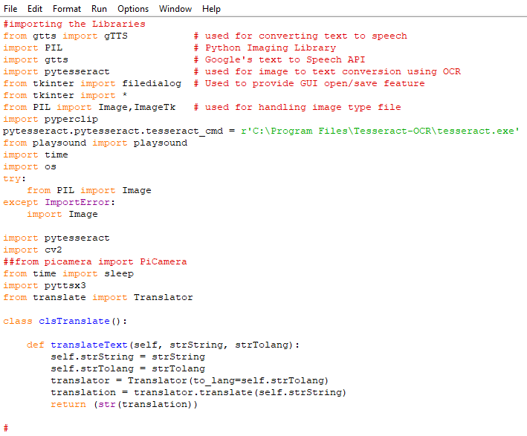
IMPLEMENTATION / SNAPSHOTS
Fig 2(a) :Converter.py

Slide 12
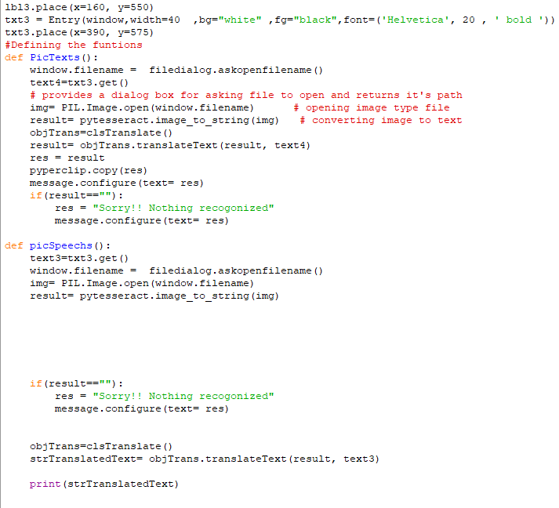
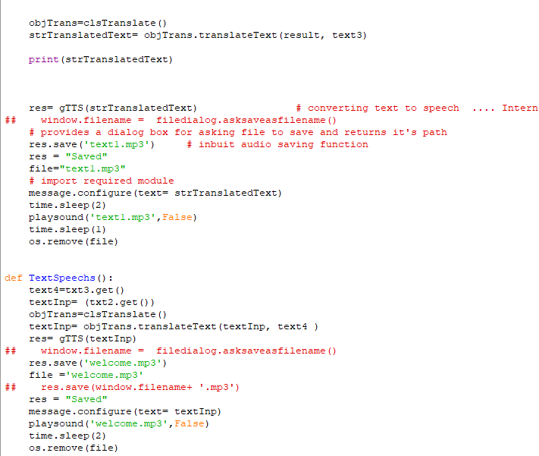
Fig 2(b) & 2(c) : Converter.py

Slide 13
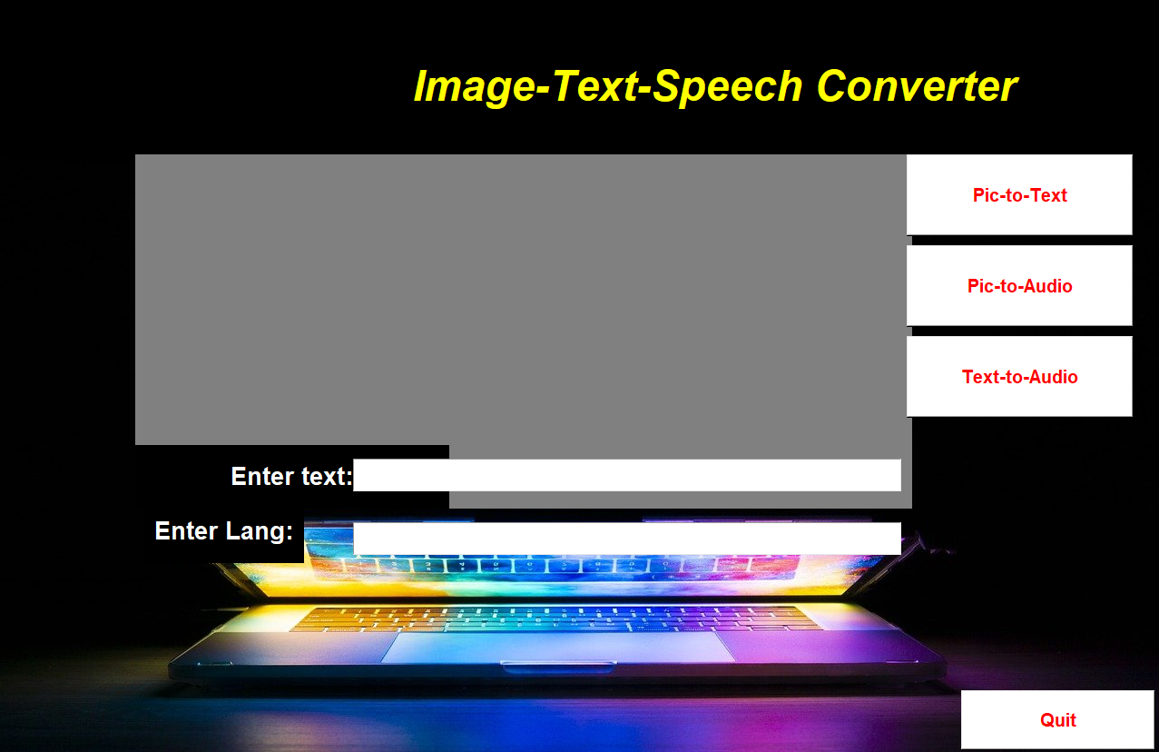
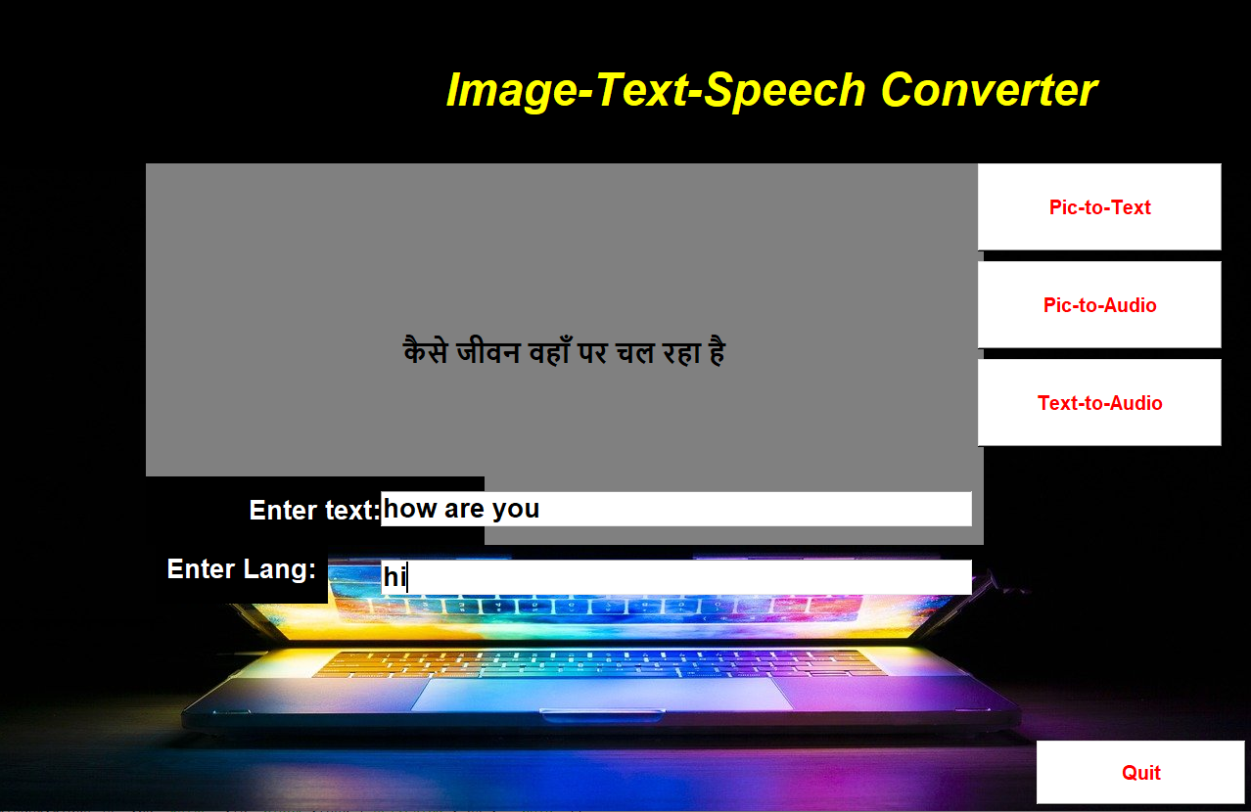
Fig 3:Clicking Image to convert it to text
Fig 4:Text converted to audio

Slide 14
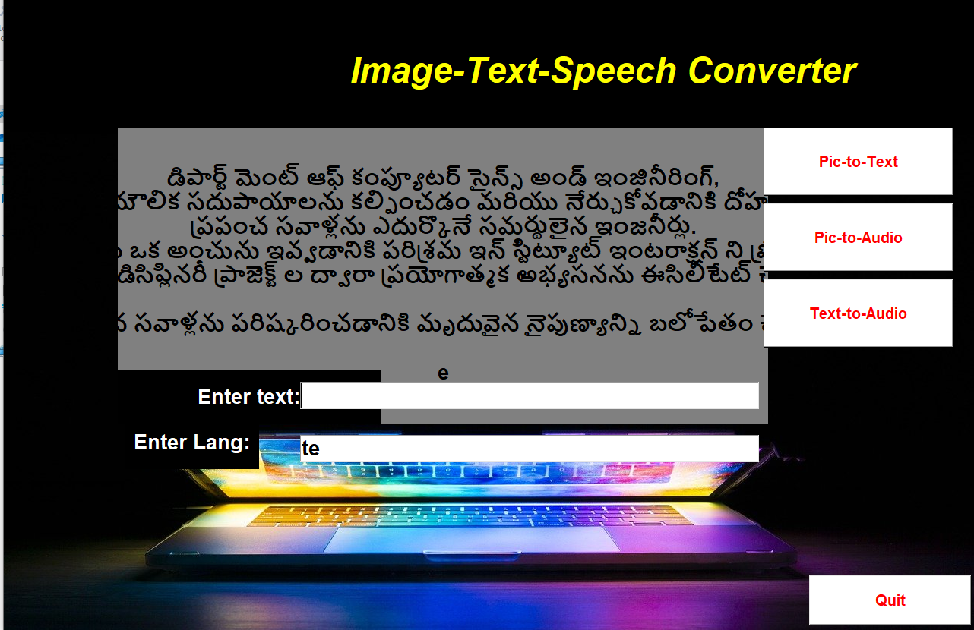
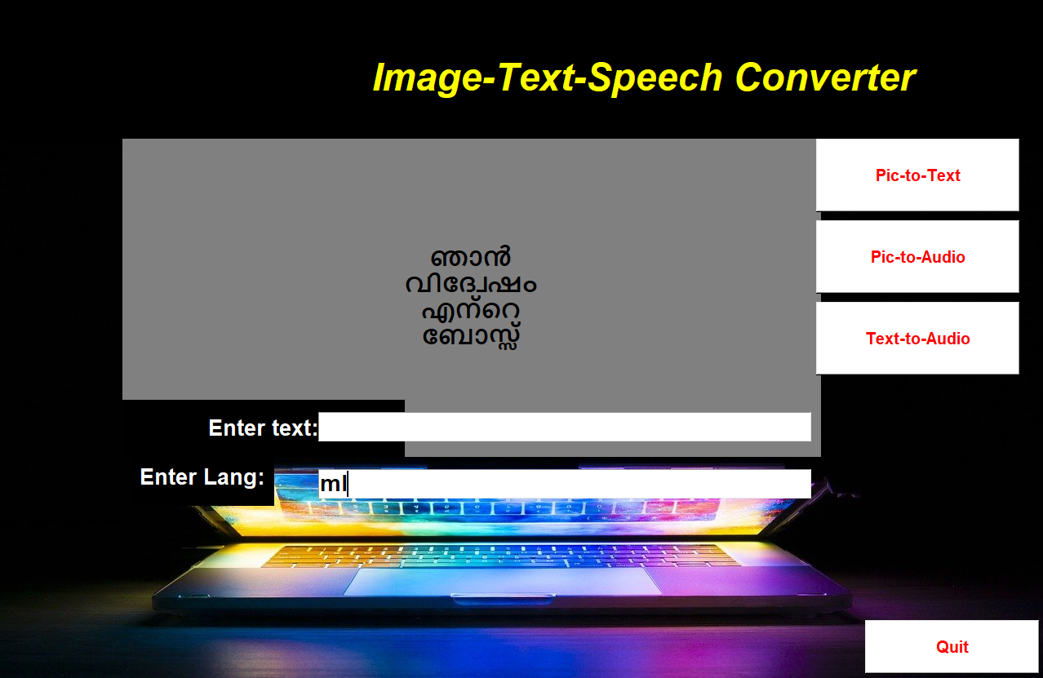
Fig 5: Image to Audio Converter
Fig 6:Image to Text Converter

Slide 15
CONCLUSION AND FUTURE ENHANCEMENTS
People with disabilities like physical impairments often find it difficult in sending a text message or typing a statement in general.
The system supports them by allowing their text through text box and performing the conversion from text to audio .
This system also helps people connect with any languages especially Indian Language from their own language.
The system basically uses two techniques Speech Recognition and Translation.
Future Enhancements:
Further we are trying to implementing on Speech to Speech translation.

Slide 16
REFERENCES
[1] Keerthana S, Meghana H, Priyanka K, Sahana V. Rao, Ashwini B “Smart Home Using Internet of Things”, proceedings of Perspectives in Communication, Embedded -systems and signal processing, 2017
[2] Sutar Shekhar, P. Sameer, Kamad Neha, Prof. Devkate Laxman, “An Intelligent Voice Assistant Using Android Platform”, IJARCSMS, ISSN: 232-7782, 2017
[3] Rishabh Shah, Siddhant Lahoti, Prof. Lavanya. K, “An Intelligent Chatbot using Natural Language Processing”, International Journal of Engineering Research , Vol.6 , pp.281-286, 2017
[4] Ravivanshikumar ,Sangpal, Tanvee, Gawand, Sahil Vaykar, “JARVIS: An interpretation of AIML with integration of gTTS and Python”, proceedings of the 2019 2nd International Conference on Intelligent Computing, Instrumentation and Control Technologies (ICICICT), Kanpur, 2019.
[5] Dhiraj Pratap Singh, Deepika Sherawat, Sonia, “Voice activated desktop assistant using Python”, proceedings of High Technology Letters, ISSN: 1006-6748, 2020.

Slide 17
THANK YOU

